Slide 1
Ethics of AI Ethics: An Evaluation of Guidelines
Responsible Data Science, Ethics of AI Ethics - Katharina Alefs, Raphael Reimann

Slide 2
Agenda
About the paper and the author
Ethics of AI Ethics
Motivation
Method
Selected ethical principles
AI Ethics in practice/effectiveness
Solution approaches
Reception of the research community
What has happened since (Technical developments, UNESCO guidelines, AI Act)
Further reading
Responsible Data Science, Ethics of AI Ethics - Katharina Alefs, Raphael Reimann

Slide 3

About the Paper and Author
Hagendorff, T. (2020). “The Ethics of AI Ethics: An Evaluation of Guidelines.” is an overview of existing AI guidelines published in Minds and Machines
Third most cited paper in the AI Ethics research field
Cluster of Excellence ML in Tübingen
Currently research group leader at University of Stuttgart
Published a lot on AI Ethics and the intersection of Machine Learning and Cognitive Science
Fun fact: World record holder
Dr. Thilo Hagendorff
Responsible Data Science, Ethics of AI Ethics - Katharina Alefs, Raphael Reimann

Slide 4
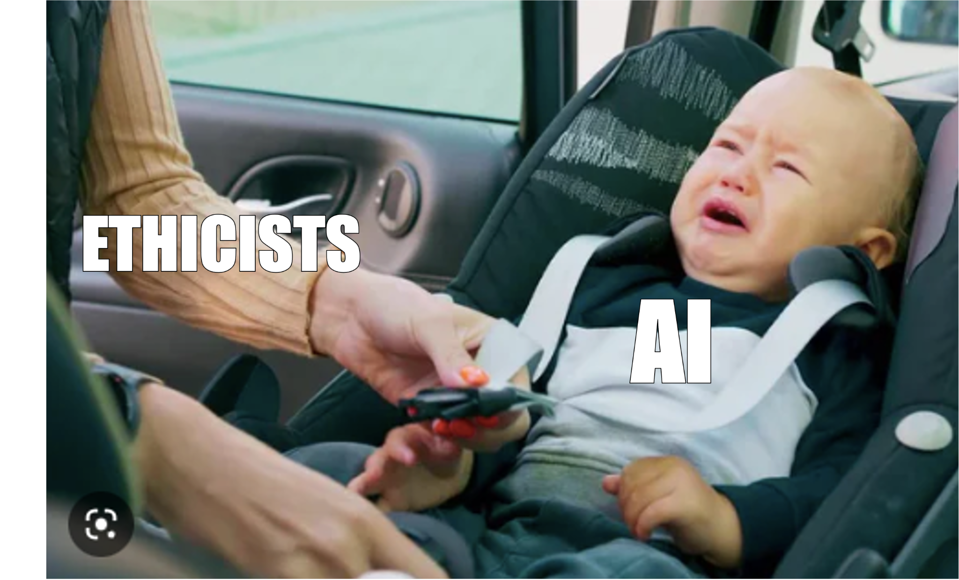
Motivation
Boom of AI technologies comes with plethora of ethical guidelines
AI Ethics lack mechanisms to reinforce its own ethical principles: No legal bindings
Little research about implementation of ethical goals and values exists
Previous research systematically scoped literature on AI Ethics (Jobin et al., 2019)
Hagendorff gives overview of issues and normative stances, shows the bigger picture of AI Ethics
Responsible Data Science, Ethics of AI Ethics - Katharina Alefs, Raphael Reimann

Slide 5
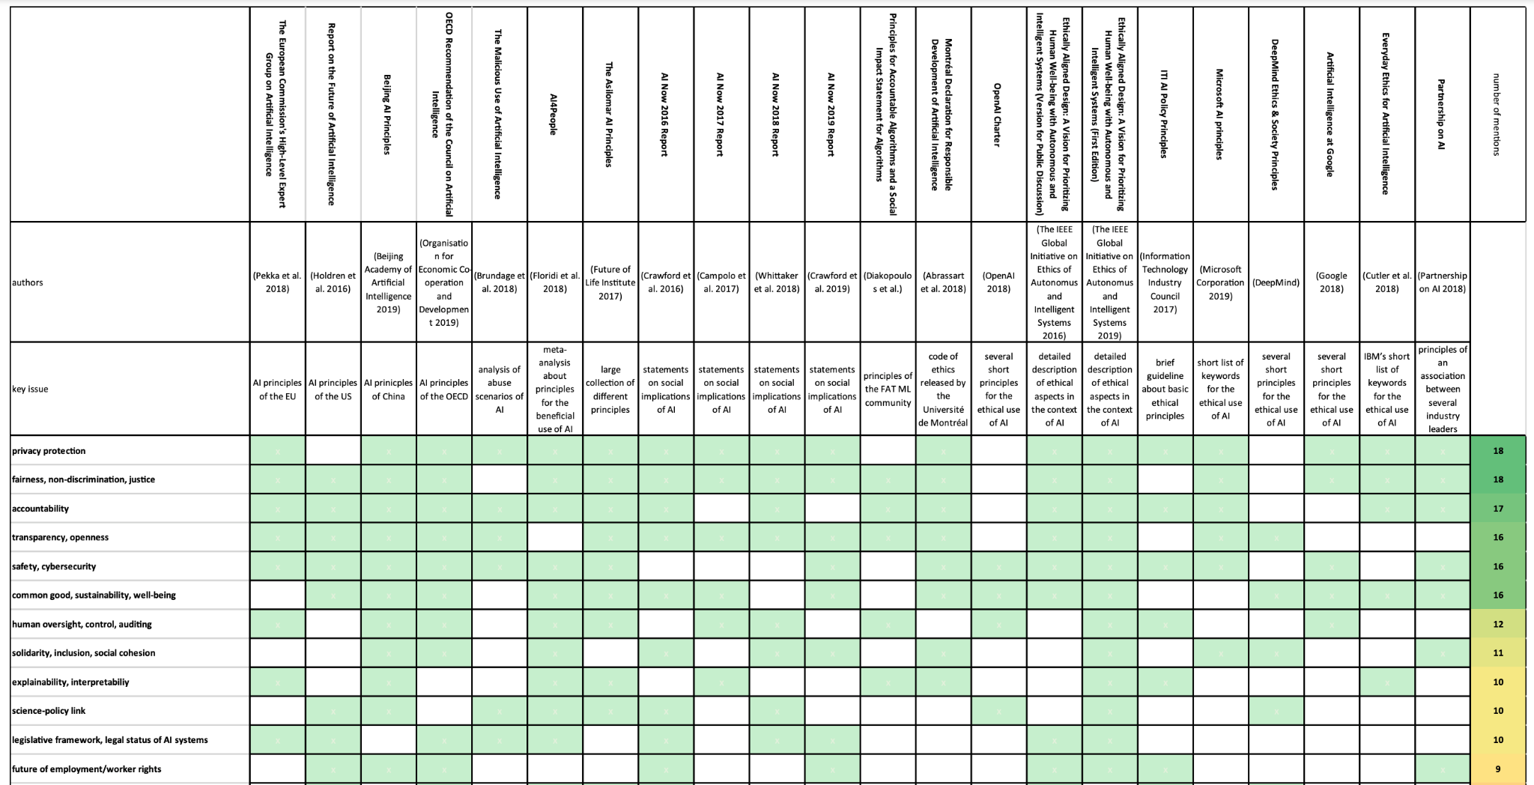
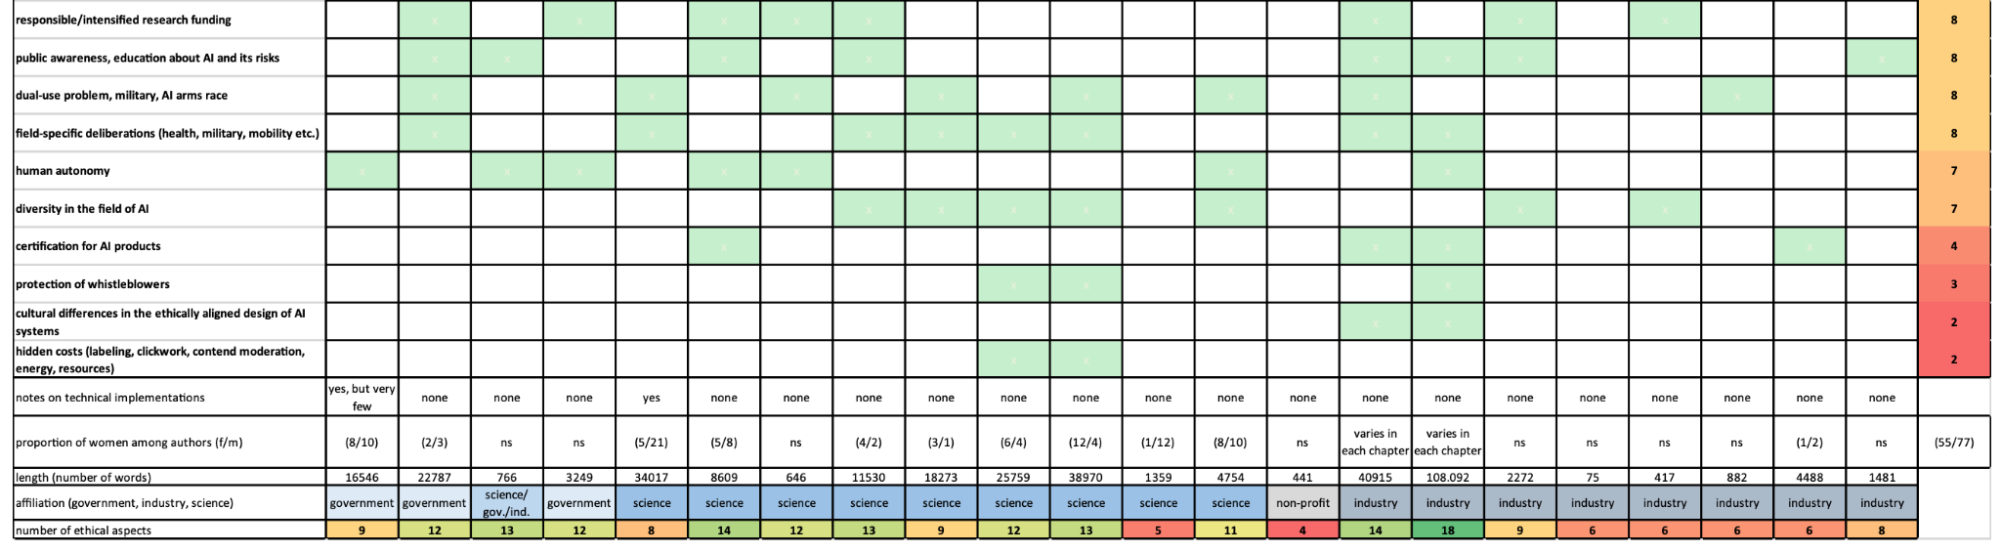
Method
The paper identifies common guidelines of AI Ethics (from science and industry as well as publications of “AI superpowers” China, US and EU)
Highlights occurence of 22 criteria across the different guidelines
Among the issues: fairness, privacy, explainability
Overview of AI Ethics guidelines (Hagendorff, 2019)
Responsible Data Science, Ethics of AI Ethics - Katharina Alefs, Raphael Reimann

Slide 6





Selected Principles
Privacy
AI systems should respect the privacy of individuals and give individuals freedom of choice over their data
Fairness
AI systems to be designed and used to maximize fairness and promote inclusivity
Accountability
Responsibility for the impacts of AI systems should be appropriately distributed
Transparency
AI systems should be designed and implemented to be understandable and to allow oversight
Safety
AI systems should be safe, performing as intended, and secure, resistant to being compromised by unauthorized parties
Responsible Data Science, Ethics of AI Ethics - Katharina Alefs, Raphael Reimann

Slide 7
Privacy
Consent: Persons data should not be used without their knowledge and permission
Control over the Use of Data: Subject should have influence over how and why their information is used
Ability to Restrict Processing: Subject has the power to have their data restricted from use in connection with AI technology
Right to Rectification: Subject has right to amend or modify information held by a data controller if it is incorrect or incomplete
Right to Erasure: Subject has right to remove their personal data
Privacy by Design: An obligation on AI developers to integrate considerations of data privacy into the construction of an AI system and the overall data lifecycle
Data Protection Laws: Recommendation that governments introduce data privacy laws
Responsible Data Science, Ethics of AI Ethics - Katharina Alefs, Raphael Reimann

Slide 8
Fairness
Non-discrimination / Prevention of Bias: Bias in training data and AI design should be mitigated to prevent discriminatory impacts
Representative and High quality data: The inputs of an AI system should accurately relate to the population of interest
Fairness: Equitable and impartial treatment of subjects by AI systems
Equality: All subjects, regardless of their background, deserve the same opportunities and protection within AI systems
Inclusiveness in Impact: Benefits from AI systems should be distributed in a just way, especially those that have been excluded historically
Inclusiveness in Design: Ethical AI systems require diverse participation in the development process
Responsible Data Science, Ethics of AI Ethics - Katharina Alefs, Raphael Reimann

Slide 9
Accountability
Impact Assessments: Human rights assessments and identification, prevention, and mitigation of negative impacts of AI technology
Environmental Responsibility: Developers of AI systems must be responsible for its ecological impacts
Evaluation and Auditing Requirement: AI systems should be auditable and continually improved
Creation of a Monitoring Body: A organization is needed to create and oversee standards and best practices in AI
Ability to Appeal: Individual who is subject of a decision made by AI should be able to challenge that decision
Remedy for Automated Decision: Remedies for AI decisions should be available
Liability: Individuals at fault for harm caused by AI system can be held accountable
Responsible Data Science, Ethics of AI Ethics - Katharina Alefs, Raphael Reimann

Slide 10
Transparency
Transparency: Oversight of AI systems should be possible
Explainability: Translation of technical concepts and decision outputs into intelligible, comprehensible formats suitable for evaluation
Open Source Data/Algorithms: Research, data, and algorithms should be open to support advancement of the technology
Open Government Procurement: Governments should be transparent about their use of AI systems
Right to Information: Individuals’ right to know about the use of, and their interaction with, AI systems
Interaction Notification: Individuals awareness when interacting with an AI system
Regular reporting: Organizations developing AI systems should disclose important information
Responsible Data Science, Ethics of AI Ethics - Katharina Alefs, Raphael Reimann

Slide 11
Safety
Safety: AI system reliably does what is intended without harming its environment
Security: AI systems ability to resist external threats
Security by Design: AI systems should be developed securely, not only in principle, but also in specific implementation decisions
Predictability: The AI systems outcome of the planning process must be consistent with the input
Responsible Data Science, Ethics of AI Ethics - Katharina Alefs, Raphael Reimann

Slide 12
What is missing?
Author criticizes omissions in existing guidelines:
Political abuse of AI systems (fake news, election fraud, bots)
Lack of diversity in AI community
Contradiction with sustainability goals (lithium mining, energy consumption, clickworkers)
Trolley problem (e.g. autonomous driving)
Algorithmic decision making vs. human
Public-private partnership, lack of transparency, danger of buy-outs
Justified omission: Artificial general intelligence (speculative)
Responsible Data Science, Ethics of AI Ethics - Katharina Alefs, Raphael Reimann

Slide 13


AI Ethics in Practice
AI Industry is huge market: 7 billion USD
Major AI conferences are sponsored by corporations
Narrative of AI Race between US, China and EU promotes recklessness and skipping over ethical considerations, needs reframing to a global cooperative project
Some ethical principles are addressed by technical fixes: cryptographic protocols for privacy, explainable AI, discrimination-aware data mining
Misuses of AI technologies: military use, biased algorithms, surveillance, disinformation campaigns, …
Responsible Data Science, Ethics of AI Ethics - Katharina Alefs, Raphael Reimann

Slide 14

Effectiveness of AI Ethics
Ethic guidelines are rather “weak”, no real mechanisms to reinforce claims
Business decisions are still driven by economic incentives first, ethical concerns often only serve PR purposes
Internal self-governing structures are non-binding and failing
Requires institutional changes: legal frameworks, independent audits, complaint mechanisms
“Ethics are like using a bicycle brake on an intercontinental flight”
Responsible Data Science, Ethics of AI Ethics - Katharina Alefs, Raphael Reimann

Slide 15
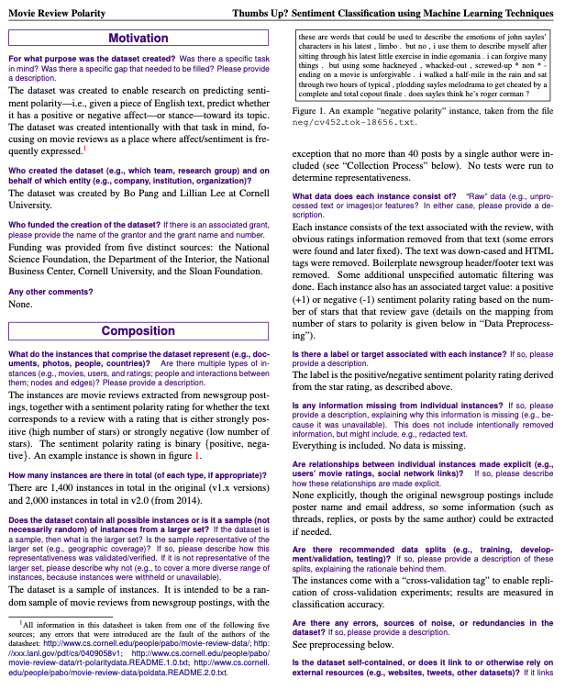
Improving AI Ethics: Proposal I
Technical Instructions
Idea: Supplement ethical guidelines with technical instructions
Ethics are currently too superficial, needs to move to a micro-level
Ethicists should be capable of understanding technical implementations
Example: standardized datasheets
Exemplary datasheet (Gebru, 2018)
Responsible Data Science, Ethics of AI Ethics - Katharina Alefs, Raphael Reimann

Slide 16
Improving AI Ethics: Proposal II
Virtue Ethics
Goal: cultivating moral character, gaining courage to refrain from actions
Ethics should not stifle activity, instead promote autonomy and freedom
At best, everyone acts (self-) responsibly, understands moral significance of their work, distances oneself from problematic decisions
Deontological Ethics
Virtue Ethics
strict rules and maxims,
focus on technology
focus on strengthening individual moral character
Responsible Data Science, Ethics of AI Ethics - Katharina Alefs, Raphael Reimann

Slide 17
Conclusion
Boom of AI technologies comes with plethora of ethical guidelines
Ethical principles do not translate to practices in reality
Ethics are not enforced, existing guidelines are often only used as a marketing tool for companies
Economic incentives often overshadow ethical considerations
Some omissions from AI guidelines are not justified and should be part of guidelines
The author argues that AI Ethics should be situation-sensitive focusing on virtues, knowledge, and responsible autonomy
Responsible Data Science, Ethics of AI Ethics - Katharina Alefs, Raphael Reimann

Slide 18
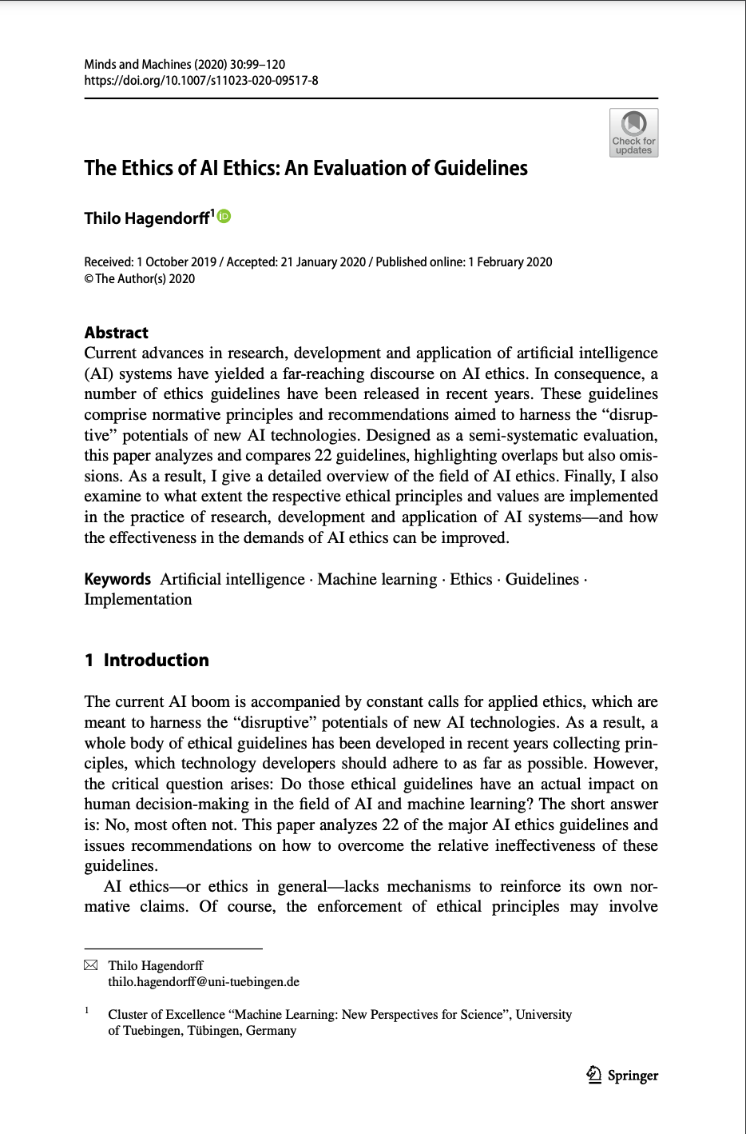
Reception & Critique
Generally well received by the research community as an overview of ethical and responsible use of AI
Christoforaki (2022) references Hagendorffs note on omissions from ethics guideline (importance of echo chambers, AI workers exploitation)
Hagendorffs notion that a principle based approach to ethics is not sufficient is well received (Ibáñez, 2021; Solanki, 2022)
Responsible Data Science, Ethics of AI Ethics - Katharina Alefs, Raphael Reimann

Slide 19
Recent technological developments
Since the publication of the paper and the guidelines analyzed in the paper, technical advances sparked the need for additional issues of AI ethics:
Copyright infringement: The use of copyrighted material in training data sets and generated content may lead to copyright infringement
Authorship: Questions on authorship of AI-generated content may raise ethical questions
Truthfulness: Users should independently assess the truthfulness and accuracy of generated information
Deepfakes and synthetic media: Generative AI raises ethical concerns when used to create fake or misleading content, impacting privacy and security
Responsible Data Science, Ethics of AI Ethics - Katharina Alefs, Raphael Reimann

Slide 20
UNESCO Recommendation
UNESCO's Recommendation on the Ethics of AI is a global standard-setting instrument on AI ethics adopted by all 193 UNESCO Member States in 2021
Focuses on broader ethical implications of AI systems in relation to UNESCO's domains
Outlines 10 key principles for ethical AI development, including safety and security, fairness and non-discrimination, proportionality and do no harm, sustainability, transparency and explainability, right to privacy, human oversight, responsibility, awareness and literacy, multi-stakeholder collaboration
Provides concrete policy actions on various domains, such as data policy, education, and research
Significant because of its global scope and potential to harmonize AI ethics across different countries and cultures. It complements other regulatory efforts, such as the EU AI Act
Responsible Data Science, Ethics of AI Ethics - Katharina Alefs, Raphael Reimann

Slide 21
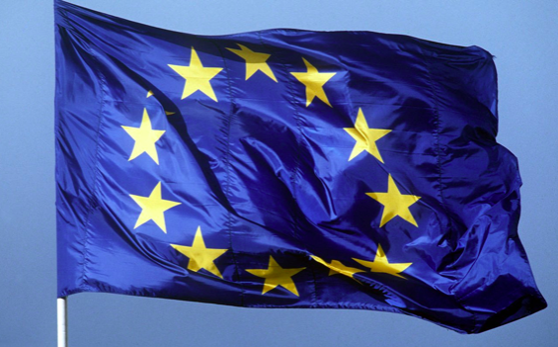
AI Act of the European Union
EUs AI act is a regulatory framework that classifies AI systems by risk and mandates various development and use requirements
The EU parliament’s committees will vote on the draft today (26 April)
AI Act goes beyond voluntary principles by introducing legally binding rules
It differentiates four different levels of risk: unacceptable risk, high risk, limited risk, and minimal risk
High risk applications will be heavily regulated, some applications will be banned
The AI act emphasizes international collaboration and outreach to promote the vision of sustainable and trustworthy AI
Responsible Data Science, Ethics of AI Ethics - Katharina Alefs, Raphael Reimann

Slide 22
Further Reading
Jobin, A., Ienca, M., & Vayena, E. (2019). Artificial Intelligence: the global landscape of ethics guidelines.
Provides overview of AI ethics, clusters ethical principles around transparency, fairness, non-maleficence, responsibility, and privacy
Hagendorff, T. (2022). Blind spots in AI ethics. AI and Ethics 2.4: 851-867.
Hagendorff, T. (2022). A virtue-based framework to support putting AI ethics into practice. Philosophy & Technology, 35(3), 55.
Responsible Data Science, Ethics of AI Ethics - Katharina Alefs, Raphael Reimann

Slide 23
Questions for Discussion
Apart from the ethical values shown earlier in our presentation (privacy, fairness, accountability, transparency, safety) what other principles should AI technologies comply with? Can you come up with groups/families of relating issues?
Considering the proposal to move towards virtue-based ethics, how can corporations and scientific institutions teach their developers to maintain and expand moral intuitions and character strength?
Responsible Data Science, Ethics of AI Ethics - Katharina Alefs, Raphael Reimann

Slide 24
Mapping of AI ethics issues
Right to Erasure
Non-discrimination
Impact Inclusion
Consent
Privacy
Human Control
Fairness
Equality
Design Inclusion
Control
Representative data
Personal information
Opt-Out
Review of decisions
Reversibility
Reliability
Safety
Liability
Resources
Integrity
Security
Disclosure
Accountability
Predictability
Sustainability
Benefit society
Transparency
Solidarity
Promotion of human values
Environment
Awareness
Auditing
Based on Hagendorff, 2020; Jobin, 2019; Fjeld, 2020; UNESCO, 2021

Slide 25
AI ethics issues (Hagendorff, 2020)
privacy protection, | future of employment/worker rights
fairness, non-discrimination, justice | responsible/intesified research funding
accountability | public awareness, education about AI and its risks
transparency, openness | dual-use problem, military, AI arms race
safety, cybersecurity | field-specific deliberations (health, military, mobility etc.)
common good, sustainability, well-being | human autonomy
human oversight, control, auditing | diversity in the field of AI
solidarity, inclusion, social cohesion | certification for AI products
explainability, interpretability | protection of whistleblowers
science-policy link | cultural differences in the ethically aligned design of AI systems
legislative framework, legal status of AI system | hidden costs (labeling, clickwork, content moderation, energy, resources)
Responsible Data Science, Ethics of AI Ethics - Katharina Alefs, Raphael Reimann

Slide 26
References
Christoforaki, Maria and Oya Deniz Beyan. “AI Ethics—A Bird’s Eye View.” Applied Sciences (2022)
Fjeld, Jessica, Nele Achten, Hannah Hilligoss, Adam Nagy, and Madhulika Srikumar. "Principled Artificial Intelligence: Mapping Consensus in Ethical and Rights-based Approaches to Principles for AI." Berkman Klein Center for Internet & Society, (2020).
Ibáñez, J.C., Olmeda, M.V. Operationalising AI ethics: how are companies bridging the gap between practice and principles? An exploratory study. AI & Soc 37, 1663–1687 (2022).
Jobin, Anna et al. “Artificial Intelligence: the global landscape of ethics guidelines.” ArXiv abs/1906.11668 (2019): n. pag.
Solanki, Pravik et al. “Operationalising ethics in artificial intelligence for healthcare: a framework for AI developers.” AI and Ethics 3 (2022): 223 - 240.
Responsible Data Science, Ethics of AI Ethics - Katharina Alefs, Raphael Reimann

